Slide 1
Visual Displays of Data
Chapter 3

Slide 2
Uses of Graphs
Positive and negative uses
Can accurately and concisely present information
Can conceal complicated data or be misleading

Slide 3
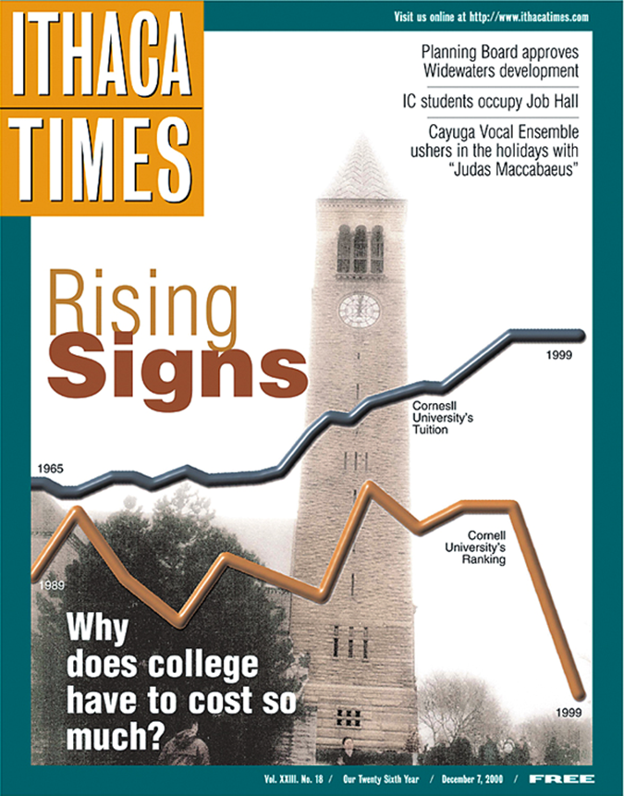
“The Most Misleading Graph Ever Published”
The Cost and Quality of Higher Education- why is it misleading?
The times are not the same for both lines (going across)
The scales are not the same
Makes it seem like Cornell is already lower
For rankings… lower is actually better, so why did they graph it this way?

Slide 4
Techniques for Misleading
The false face validity lie
Method seems to represent what it says, but does not actually
e.g., using yelling as a measure of aggression

Slide 5
Techniques for Misleading
The biased scale lie
Scaling to skew the results, or leading questions
e.g., goodreads book scale (did not like, it was ok, liked it, really liked it, it was amazing)

Slide 6
Techniques for Misleading
The sneaky sample lie
When participants are preselected or self selected to provide data.
e.g., rate my professor

Slide 7
More Techniques
The interpolation lie
Assumes that a value between 2 data points follows the same pattern
The extrapolation lie
Assumes knowledge outside of the study

Slide 8
More Techniques
The inaccurate values lie
Uses scaling to distort portions of the data
The outright lie
Making up data!

Slide 9
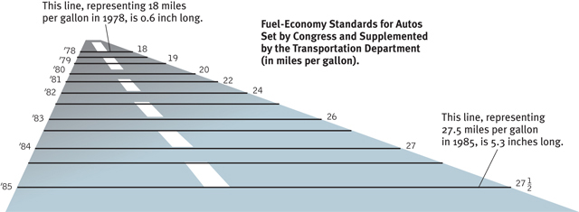
The Inaccurate Value Lie

Slide 10
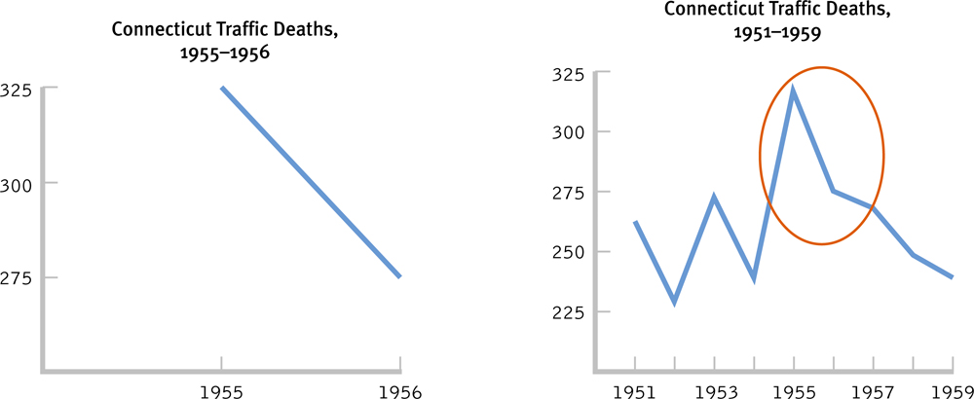
Which of the two graphs is misleading?

Slide 11
Scatterplots
Graphs that depict the relation between two scale variables
Range-frame (!!) – x and y axis show the range of the variable
Observing every data point
Linear relationships – relationship between variables is a straight line
Nonlinear relationships – relationship between variables is curved
Performance & Anxiety

Slide 12
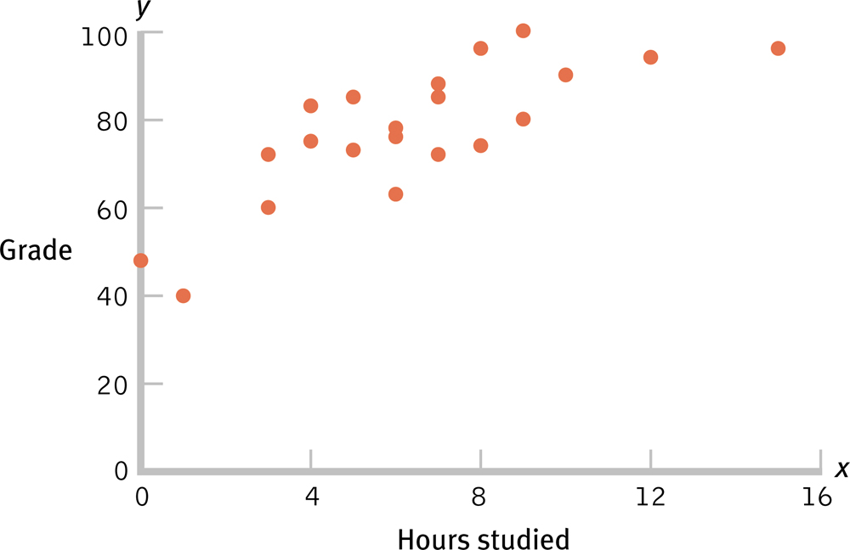
Scatterplot of Hours Studied and Statistics Grade

Slide 13
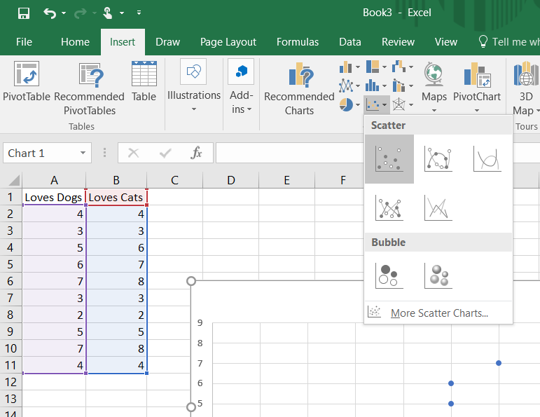
How-To Excel
Enter your data/open data file
You do need all of the data points to make this type of graph
Select your data and go to the “Insert” tab to insert a scatter plot

Slide 14
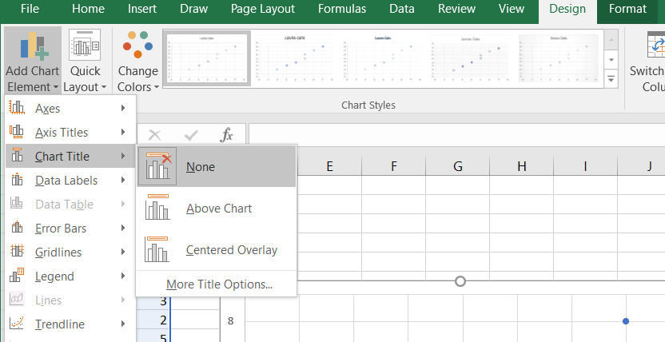
How-To Excel
From here you can change a bunch of stuff
For APA format you will remove the title

Slide 15
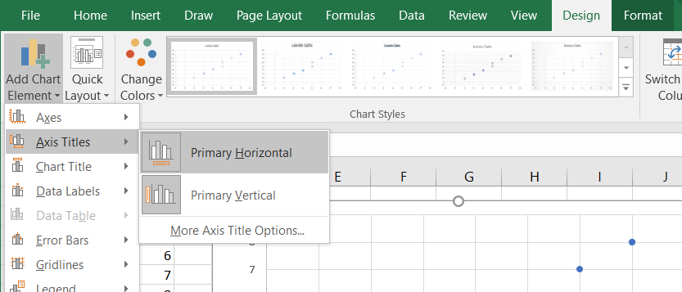
How-To Excel
Also need to add x- and y-axis labels

Slide 16
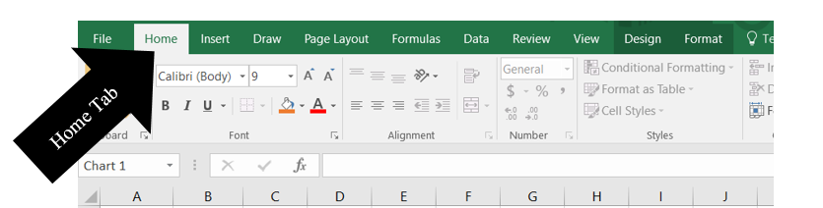
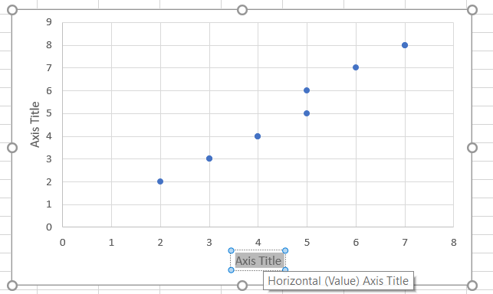
How-To Excel
Then change the labels

Slide 17
Line Graphs
Line graphs are best for scale variables (remember this is interval/ratio)
Especially useful for trends over time
Two types:
Line of best fit (correlations)
Time series plot (changes over at points in time)

Slide 18
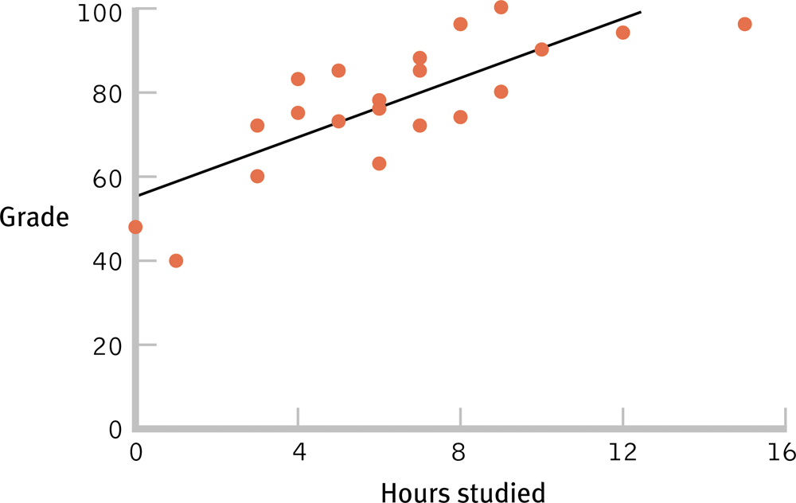
The Line of Best Fit

Slide 19
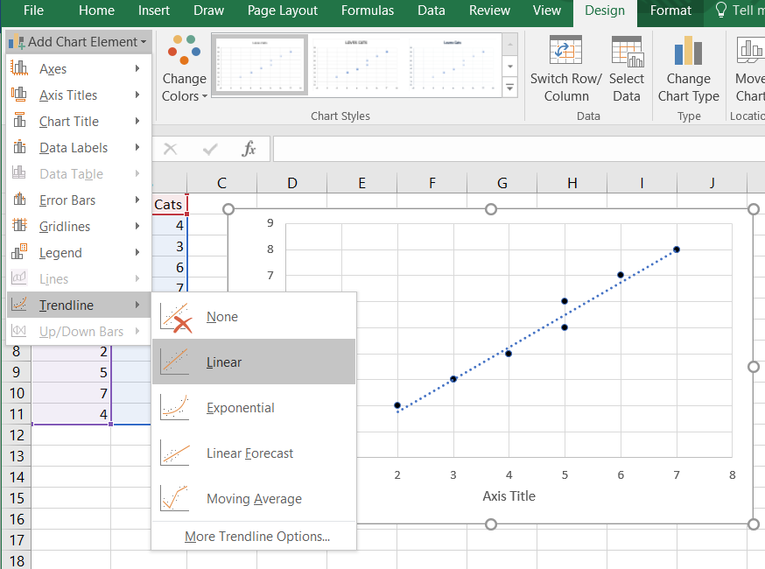
How-To Excel
Let’s add a line of best fit!

Slide 20
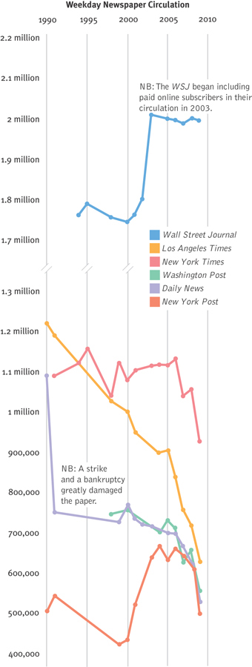
Weekly Newspaper Circulation

Slide 21
Bar Graphs
When the IV is nominal or ordinal and the DV is scale
Meaning X = groups (IV), Y = interval/ratio (DV)
Each bar usually represents an AVERAGE score
Useful for looking at differences in groups

Slide 22
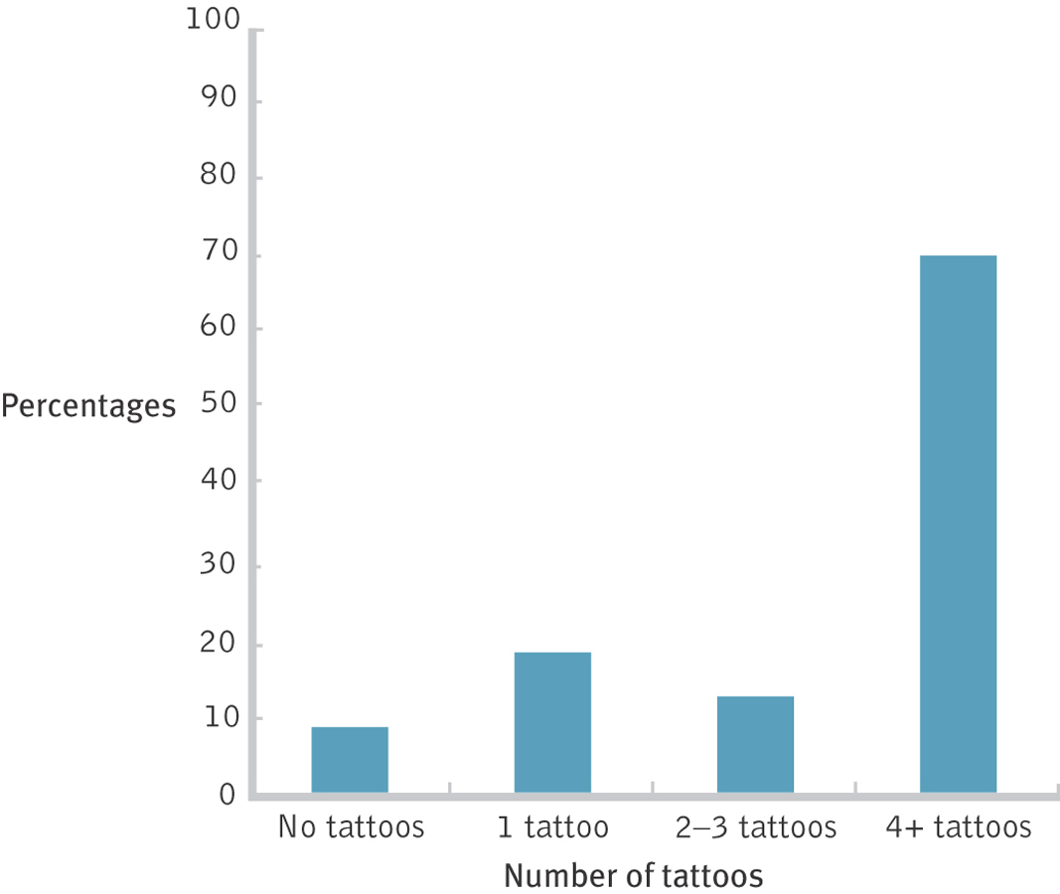
Bar Graphs Highlight Differences Between Means

Slide 23
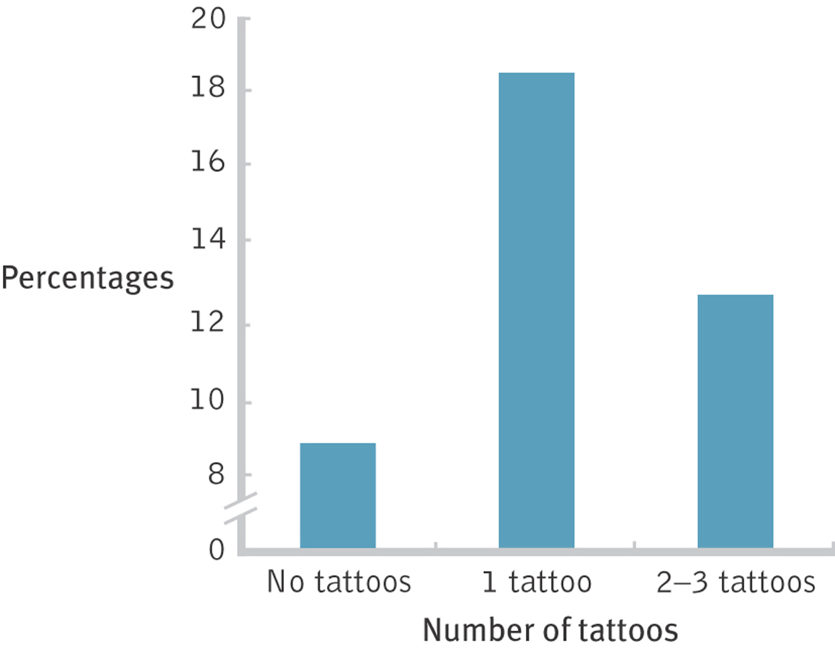
Deceiving with the Scale

Slide 24
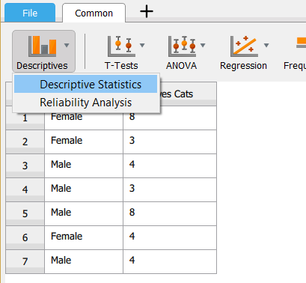
How-To Excel
If you are given the raw data, you will need to calculate means and standard deviations in JASP before being able to make a bar graph. To do this you will go to “Descriptive” → “Descriptive Statistics”

Slide 25
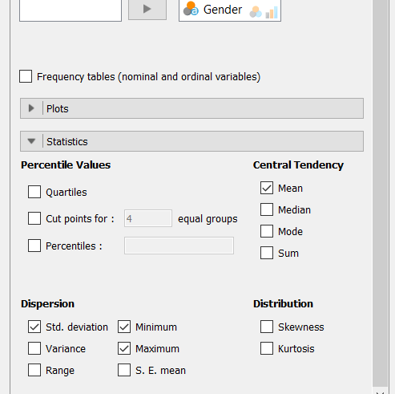
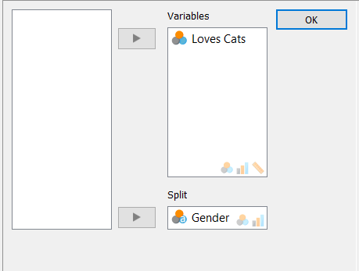
How-To Excel
Next you will put the IV in the “Split” box to get descriptives for the levels of the IV separately, and the DV in the “Variables” box, then select the descriptives you need.
Mean
Statistics
Standard Deviation

Slide 26
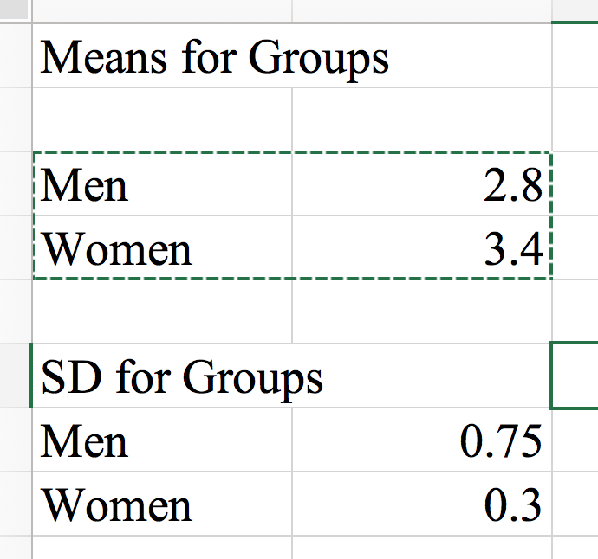
How-To Excel
Now you can use the numbers from your output and enter those values into Excel by group.

Slide 27
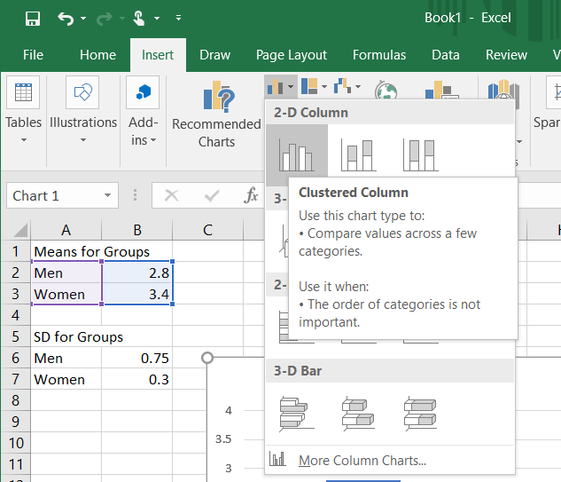
How-To Excel
Highlight the variable names and means
Click on the “Insert” tab and insert a bar graph

Slide 28
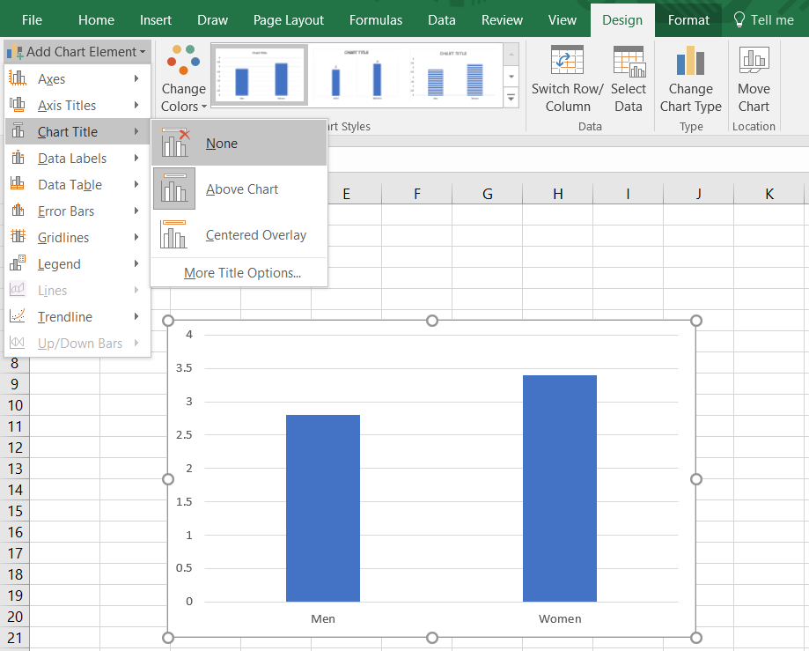
How-To Excel
For APA format you will remove the title

Slide 29
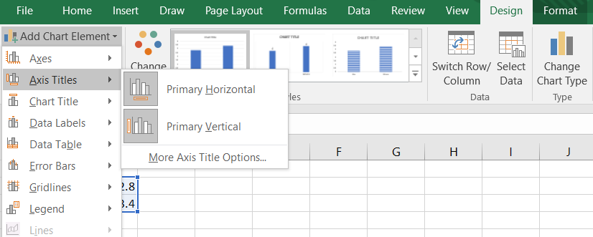
How-To Excel
Also need to add x- and y-axis labels

Slide 30
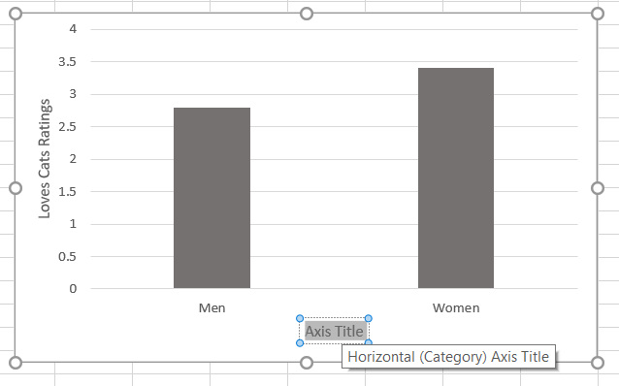
How-To Excel
Then change the labels

Slide 31
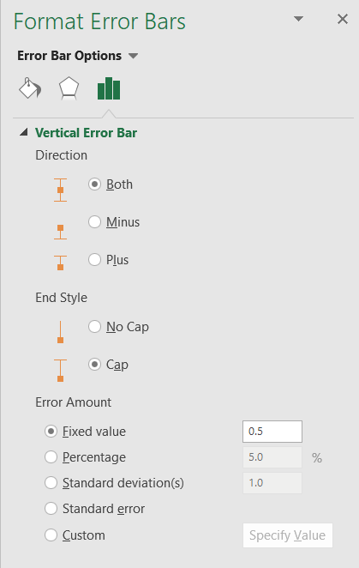
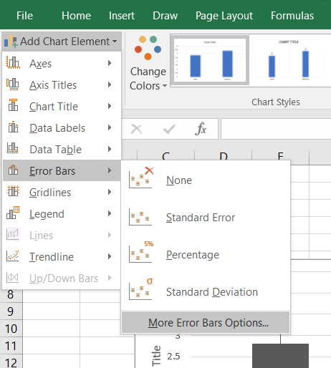
How-To Excel
Add error bars
Select “Custom” → “Specify Value”

Slide 32
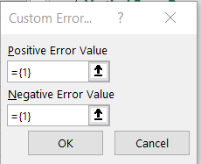
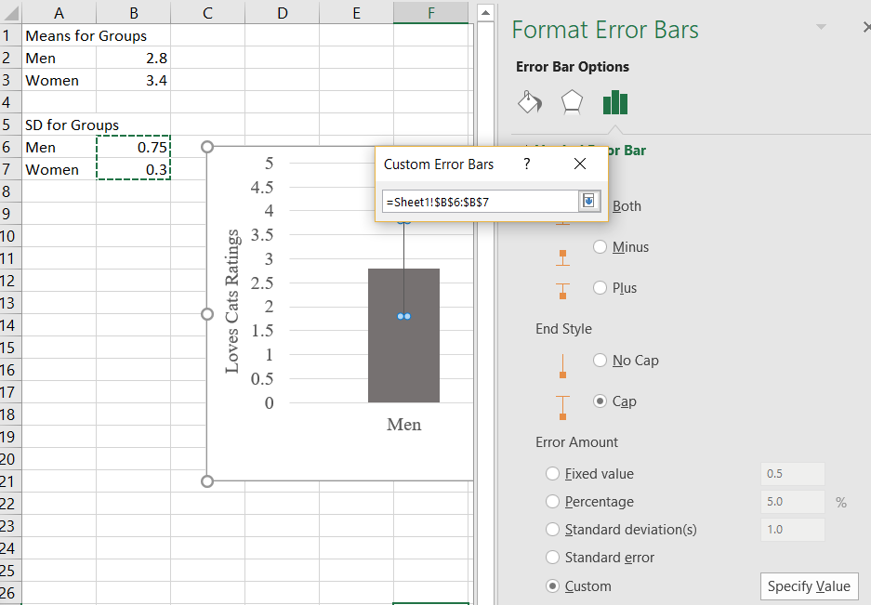
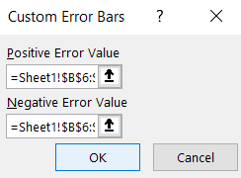
How-To Excel
Select the cells with the standard deviation values for both the positive and negative error values

Slide 33
Check Your Learning
What is the best type of graph to depict the following:
Depression levels and stress levels for 150 university students. Is depression related to stress?
Mean years of education for six regions of the United States. Are education levels higher in some regions than in others?

Slide 34
Choosing the Graph Based on Variables
One scale variable (with frequencies): histogram or frequency polygon
One scale independent and one scale dependent variable: scatterplot or line graph
One nominal or ordinal independent and one scale dependent variable: bar graph
Two+ nominal or ordinal independent and one interval dependent variable: bar graph

